Slide 1

Girls Are Attractive

Slide 2
INFLUENCE

Slide 3

INCREASE YOUR

Slide 4
INCREASE YOUR

Slide 5


Slide 6
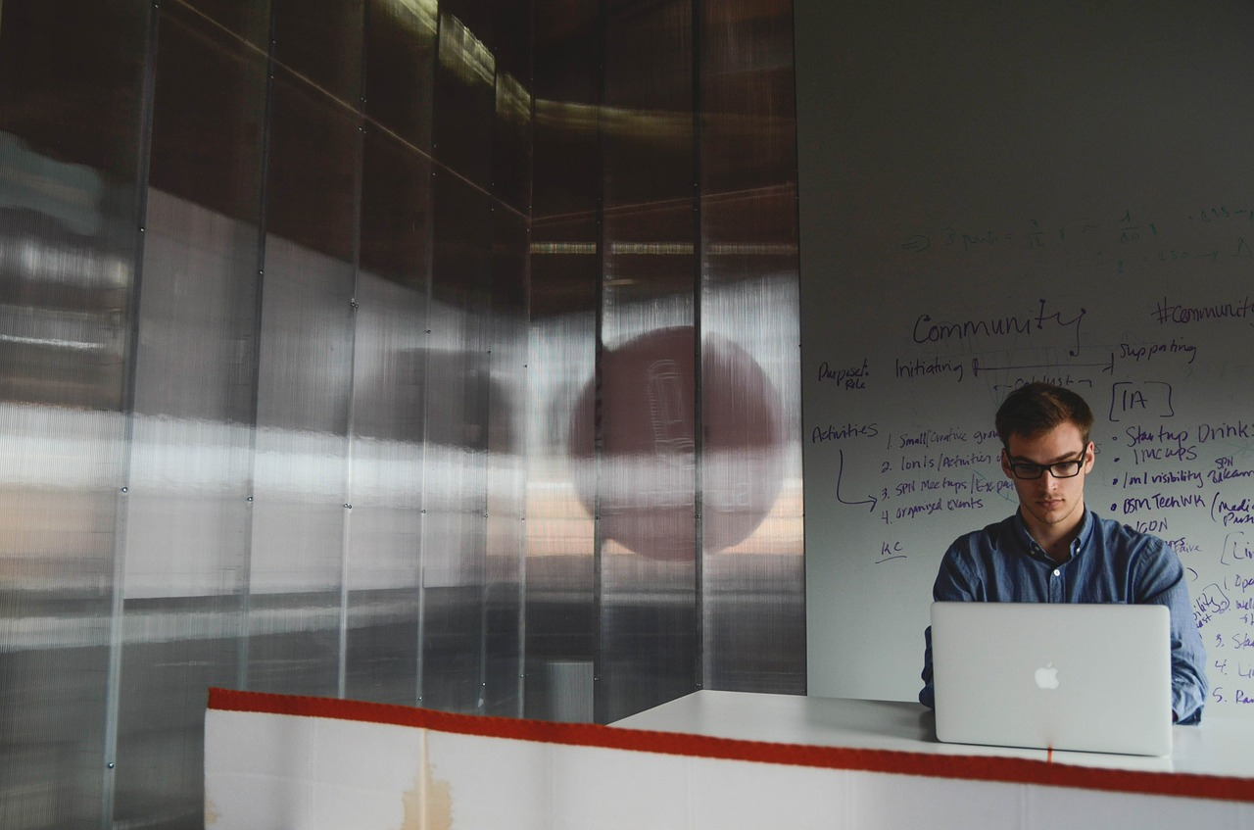

Slide 7
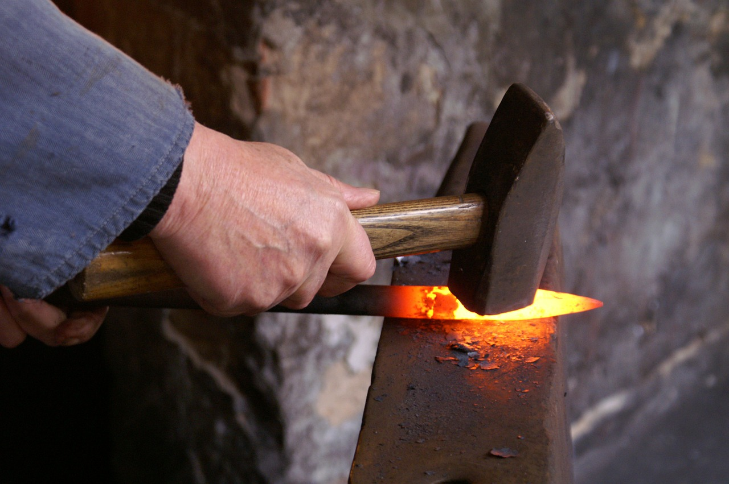

Slide 8


Slide 9


Slide 10


